Slide 1



Stack
swatimali@somaiya.edu

Slide 2
Outline
Stack – concept
Stack ADT
Stack operations
Stack implementations
Stack applications
Summary
Queries?

Slide 3
Stack
Last In First Out
Elements can be added or removed only from one end
Gives access only to element at the top of data structure

Slide 4
What is this good for ?
To store history in a Web browser
Undo sequence in a any application software or text editor
Saving local variables during function calls
Recursions
Watchlists?

Slide 5
A Stack
Definition:
An ordered collection of homogenous data items
Can be accessed at only one end (the top)
Operations:
Create an empty stack
check if it is empty
Push: add an element to the top
Pop: remove the top element
Peek: retrieve the top element(Not the deletion)
Destroy : remove all the elements one by one and destroy the data structure

Slide 6
The Stack ADT: Value definition
Abstract typedef StackType(ElementType ele)
Condition: none

Slide 7
Stack ADT: Operator definition
1. Abstract StackType CreateEmptyStack()
Precondition: none
Postcondition: CreateEmptyStack is created
2. Abstract StackType PushStack(StackType Stack, ElementType Element)
Precondition: Stack not full or NotFull(Stack)= True
Postcondition: PushStack: stack= stack + Element at the top
Or Stack= original stack with new Element at the top

Slide 8
Stack ADT: Operator definition
3. Abstract ElementType PopStack(StackType stack)
Precondition: Stack not empty or NotEmpty(Stack)= True
Postcondition: PopStack= element at the top,
Stack = stack - Element at the top
Or Stack= original stack without top Element
4. Abstract DestroyStack(StackType Stack)
Precondition: Stack not empty or NotEmpty(Stack)= True
Postcondition: Element from the stack are removed one by one starting from top to bottom.
Empty(Stack)= True

Slide 9
Stack ADT: Operator definition
5. Abstract Boolean NotFull(StackType stack)
Precondition: none
Postcondition: NotFull(Stack)= true if Stack is not full
NotFull(Stack)= False if Stack is full.
6. Abstract Boolean NotEmpty(StackType stack)
Precondition: none
Postcondition: NotEmpty(Stack)= true if Stack is not empty
~Empty(Stack)= False if Stack is empty.

Slide 10
Stack ADT: Operator definition
7. Abstract ElementType Peep(StackType stack)
Precondition: Stack not empty or NotEmpty(Stack)= True
Postcondition: PeepStack= element at the top,
Stack = original stack

Slide 11
Exercise: Stacks
Push(8) |  | 8 |  | Top
Push(3) |  | 8 | 3 |  | Top
Pop() |  | 8 |  | Top
Push(2) |  | 8 | 2 |  | Top
Push(5) |  | 8 | 2 | 5 |  | Top
Pop() |  | 8 | 2 |  | Top
Pop() |  | 8 |  | Top
Push(9) |  | 8 | 9 |  | Top
Push(1) |  | 8 | 9 | 1 |  | Top

Slide 12
Implementing a Stack
At least three different ways to implement a stack
array
vector
linked list
Which method to use depends on the application
what advantages and disadvantages does each implementation have?

Slide 13
Implementing Stacks: Array
Advantages -best performance
Disadvantage - fixed size
Basic implementation
initially empty array
field to record where the next data gets placed into
if array is full, push() returns false
otherwise adds it into the correct spot
if array is empty, pop() returns null
otherwise removes the next item in the stack

Slide 14
Implementing a Stack: Vector
Advantages
grows to accommodate any amount of data
second fastest implementation when data size is less than vector size
Disadvantage
slowest method if data size exceeds current vector size
have to copy everything over and then add data
wasted space if anomalous growth
vectors only grow in size – they don’t shrink
can grow to an unlimited size
I thought this was an advantage?
Basic implementation
virtually identical to array based version

Slide 15
Implementing a Stack: Linked List
Advantages:
always constant time to push or pop an element
can grow to an infinite size
Disadvantages
the common case is the slowest of all the implementations
Basic implementation
list is initially empty
push() method adds a new item to the head of the list
pop() method removes the head of the list

Slide 16
Writing an algorithm
Specify algorithm name, list of inputs, data types of the inputs and return data types clearly
Specify purpose of the algorithm
Algo should produce at least one Output
Definiteness: Each step must be clear and unambiguous.
Should react correctly to all valid and invalid inputs
Finiteness: If we trace the steps of an algorithm, then for all cases, the algorithm must terminate after a finite number of steps.
Effectiveness:
Comment Session: Comment is additional info of program for easily modification. In algorithm comment would be appear between two square bracket []. For example: [ this is a comment of an algorithm ].

Slide 17
Stack ADT: Array Implementation
Algorithm StackType CreateStack()
//This Algorithm returns an empty stack- stack
{ integer StackTop =-1;
Return stack;
}
2. Algorithm StackType PushStack(StackType Stack, ElementType Element)
// This algorithm accepts a StackType stack and ElementType Element as input and adds ‘Element’ at the top of ‘stack’. StackTop is an integer index that holds current value of StackTop position.
{
if NotFull(Stack)= True
stack[++StackTop]= Element
Else “Error Message”
}

Slide 18
Stack ADT: Array Implementation
3. Algorithm ElementType PopStack(StackType stack)
// This algorithm accepts a stack as input and returns ‘Element’ at the top of ‘stack’.
{ if NotEmpty(Stack)= True
Return Stack[StackTop--]
Else print “Error Message”
}
4. Abstract DestroyStack(StackType Stack)
//This algorithm returns all the elements from Stack in LIFO order and destroys the data structure
{ if NotEmpty(Stack) = true
while(NotEmpty(Stack))
print PopStack(Stack)
else print “Error Message”
}

Slide 19
Stack ADT: Array Implementation
5. Abstract Boolean NotFull(StackType stack)
// This algorithm returns true if the stack is not full, false otherwise.
{ if NotFull(Stack)
retrun True
else
return False
}
6. Abstract Boolean NotEmpty(StackType stack)
// This algorithm returns true if the stack is not empty, false otherwise.
{ if NotEmpty(Stack)
retrun True
else
return False
}

Slide 20
Stack ADT: Array Implementation
7. Abstract ElementType Peek(StackType stack)
//// This algorithm accepts a stack as input and returns ‘Element’ at the top of ‘stack’.
{ if NotEmpty(Stack)= True
Return Stack[StackTop]
Else print “Error Message”
}

Slide 21
Implementing Stacks: Linked List
Struct NodeType{
ElementType Element;
NodeType Next;
}
Algorithm StackType CreateStack()
//This Algorithm creates and returns an empty stack- pointed by a pointer-Top
{ createNode(Top);
Top =NULL;
}
Top

Slide 22
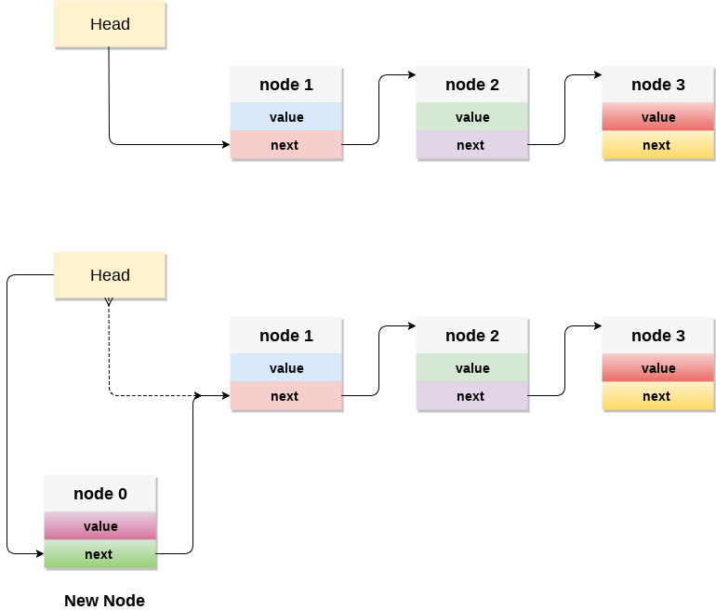
Implementing Stacks: Linked List
Image Courtesy: https://www.javatpoint.com/ds-linked-list-implementation-of-stack

Slide 23
Implementing Stacks: Linked List
2. StackType PushStack(StackType Stack, NodeType NewNode)
// This Algorithm adds a NewNode at the top of ‘stack’. Top is an pointer that points to the topmost Stack node.
{ if Top ==NULL // first element in stack
NewNode->Next = NULL;
Top=NewNode;
Else NewNode->Next=Top;// General case
Top=NewNode;
}

Slide 24
Implementing Stacks: Linked List
3. Algorithm ElementType PopStack(StackType stack)
//This algorithm returns value of ElementType stored in topmost node of stack. Temp is a temproary node used in pop process.
{ if Top==NULL
Print “Underflow”
Else
{
createNode(Temp);
Temp=Top;
Top= Top->next;
Return(temp->Data);
}
}

Slide 25
Implementing Stacks: Linked List
4. Abstract DestroyStack(StackType Stack)
//This algorithm returns values stored in data structure and free the memory used in data structure implementation.
{{ if Top==NULL
Print “Underflow”
Else createNode(Temp);
while(NotEmpty(stack))
{
Temp=Top;
Top= Top->next;
Return(temp->Data);
}
}

Slide 26
Implementing Stacks: Linked List
5. Abstract ElementType Peep(StackType stack)
//This algorithm returns value of ElementType stored in topmost node of stack.
{ if Top==NULL
Print “Error Message”
Else
Return(Top->Data);
}

Slide 27
6. Abstract DisplayStack(StackType stack)
//This algorithm Prints all the Elements stored in stack. Temp purpose?
{ if Top==NULL
Print “Error Message”
Else {createNode(Temp)
Temp=Top;
While(Temp!=Null)
Print(Temp->Data);
Temp= Temp->next;
}
}

Slide 28
Implementing Stacks: Linked List
Push(8)
Push(3)
Pop()
Push(2)
Push(5)
Pop()
Peek()
Peek()
Pop()
Push(9)
Push(1)

Slide 29
Implementing Stacks: Linked List
Create empty stack
Push(8)
Top

Slide 30
Implementing Stacks: Linked List
Top
Push(8)
NewNode
8
Top
2
NewNode
8
1
Top
8

Slide 31
Stack Applications
Stacks are a very common data structure
Compilers(parsing data between delimiters/ brackets)
operating systems (program stack)
virtual machines
manipulating numbers
pop 2 numbers off stack, do work (such as add)
push result back on stack and repeat
Algorithms
backtracking
artificial intelligence
finding a path

Slide 32
Stack applications

Slide 33
1. Parentheses Matching Algorithm
Algorithm Boolean ParenMatch(X,n):
Input: An array X of n tokens, each of which is either a grouping symbol, a
variable, an arithmetic operator, or a number
Output: true if and only if all the grouping symbols in X match
Let S be an empty stack
for i=0 to n-1 do
if X[i] is an opening grouping symbol then
S.push(X[i])
else if X[i] is a closing grouping symbol then
if S.isEmpty() then
return false {nothing to match with}
if S.pop() does not match the type of X[i] then
return false {wrong type}
if S.isEmpty() then
return true {every symbol matched}
else
return false {some symbols were never matched}

Slide 34
Parentheses Matching Algorithm
i/p string= {()()}
i/p= {, push |  | i/p= (, push |  | i/p= ), pop; ToS=(, match= true |  | i/p= (, push |  | i/p= ), pop; ToS=(, match= true |  | i/p= }, pop; ToS= {, match= true
 |  | ( |  |  |  | (
{ |  | { |  | { |  | { |  | {
step 1 |  | Step 2 |  | step 3 |  | Step 4 |  | step 5 |  | step 6
After step 6, stack is empty. So given string of parenthesis is balanced

Slide 35
Parentheses Matching Algorithm
i/p string= {(){()}
i/p= {, push |  | i/p= (, push |  | i/p= ), pop; ToS=(, match= true |  | i/p= {, push |  | i/p= (, push |  | i/p= ), pop; ToS=(, match= true |  | i/p= }, pop; ToS=}, match= true |  | i/p= }, pop; underflow; Error
 |  |  |  |  |  |  |  | (
 |  | ( |  |  |  | { |  | { |  | {
{ |  | { |  | { |  | { |  | { |  | { |  | {
step 1 |  | Step 2 |  | step 3 |  | Step 4 |  | step 5 |  | step 6 |  | step 7 |  | step 8
After step 8, stack is nonempty but there are more characters in input string. So given string of parenthesis is not balanced

Slide 36
2. Infix to postfix
Infix: operand operator operand
E.g a+b
Postfix: operand operand operator
E.g. a b +
Operator Precedence
^ - exponential operator
*, /
+, -
Infix to postfix expression with parenthesis

Slide 37
2. Infix to postfix
Infix to postfix expression with parenthesis
(((a+b)*(c/d))^e)
((ab+ * cd/) ^ e)
((ab+cd/ *) ^ e)
ab+cd/*e^

Slide 38
2. Infix to postfix
Infix to postfix expression with parenthesis
(((A + B) * C) – ((D - E) * (F + G)))
((A B + * C) – (D E - * F G + ))
( A B + C *) – ( DE – FG + *)
A B + C * DE – FG + * -

Slide 39
Infix to postfix
Infix to postfix expression without parenthesis
A + B * C - D - E * F + G
A + BC* - D - EF* + G
ABC*+ - D - EF* + G
ABC*+D- - EF* + G
ABC*+D-EF*- + G
ABC*+D-EF*-G+

Slide 40
Infix to postfix process without parenthesis
Algorithm String InfixToPostfix(String X)
//The algorithm accepts an infix expression ‘X’ and converts it into a postfix expression output_list. Opstack is a stack to process the operators during the conversion process.
Create an empty stack called opstack for keeping operators. Create an empty list for output.
Scan the input string X from left to right.
If the input is an operand, append it to the end of the output list.
If the token is an operator, *, /, +, or -, push it on the opstack. However, first remove any operators already on the opstack that have higher or equal precedence and append them to the output list.
When the input expression has been completely processed, check the opstack. Any operators still on the stack can be removed and appended to the end of the output_list.
Return Output_list.

Slide 41
A + B * C - D - E * F + G
Input char | Opstack | Output
A |  | A
+ | + | A
B | + | AB
* | +* | AB
C | +* | ABC
- | - | ABC*+
D | - | ABC*+D
- | - | ABC*+D-
E | - | ABC*+D-E
* | -* | ABC*+D-E
F | -* | ABC*+D-EF
+ | + | ABC*+D-EF*-
G | + | ABC*+D-EF*-G
NULL | EMPTYSTACK | ABC*+D-EF*-G+

Slide 42
SOLVE : M*N+T^Q/F*A+B
MN*TQ^F/A*+B+

Slide 43
Infix to postfix process with parenthesis
Algorithm String InfixToPostfix(String X)
//The algorithm accepts an infix arithmetic expression ‘X’ and converts it into a postfix expression Y. Opstack is a stack to process the operators during the conversion process.
Scan X from left to right and repeat Step 2 to 5 for each element of X until the OpStack is empty.
If an operand is encountered, add it to Y
If a left parenthesis is encountered, push it onto OpStack.
If an operator is encountered ,then:
Repeatedly pop from OpStack and add to Y each operator (on the top of Stack) which has the same precedence as or higher precedence than operator until an opening parenthesis is encountered.
Add operator to OpStack.
5. If a right parenthesis is encountered ,then:
Repeatedly pop from OpStack and add to Y each operator (on the top of Stack) until a left parenthesis is encountered.
Remove the left Parenthesis.
6. Return Y

Slide 44
Input: input expression:( ((A + B) * C) - ((D - E) * (F + G)))
Input char | stack | Output
( | (
( | ((
( | (((
A | ((( | A
+ | (((+ | A
B | (((+ | AB
) | (( | AB+
* | ((* | AB+
C | ((* | AB+C
) | ( | AB+C*
- | (- | AB+C*
( | (-( | AB+C*
( | (-(( | AB+C*
D | (-(( | AB+C*D
- | (-((- | AB+C*D
E | (-((- | AB+C*DE
) | (-( | AB+C*DE-
* | (-(* | AB+C*DE-
( | (-(*( | AB+C*DE-
F | (-(*( | AB+C*DE-F
+ | (-(*(+ | AB+C*DE-F
G | (-(*(+ | AB+C*DE-FG
) | (-(* | AB+C*DE-FG+
) | (- | AB+C*DE-FG+*
) | EMPTY | AB+C*DE-FG+*-

Slide 45
3. Evaluation of postfix expression
Create a stack for storing operands
Scan the input expression from left to right
If the element is operand, push it onto the stack
If the element is operator, pop two operands, evaluate and push the result onto the stack
If the expression is over, the stack contains the final answer

Slide 46
Input: input expression: AB+C*DE-FG+*-
e.g. A=2, B=3,C=1,D=4,E=5, F=7, G=8
Input char | stack
2 | 2
3 | 2, 3
+ | (2+3)=5
1 | 5, 1
* | (5*1)= 5
4 | 5,4
5 | 5,4,5
- | 5,-1
7 | 5,-1,7
8 | 5,-1,7,8
+ | 5,-1,15
* | 5,-15
- | 20

Slide 47
4. Reverse a string using Stack
Create an empty stack.
One by one push all characters of string to stack.
One by one pop all characters from stack and put them back to string.

Slide 48
5. Check if a string is palindrome
Push the input string onto the stack
POP characters ONE by one from stack and compare with string characters from left to right
If all comparisons are true, the string is palindrome

Slide 49
6. Recursion
Definition: calling the same function again directly or indirectly
Concept: represent a problem in terms of one or more smaller problems, and add one or more base conditions that stop the recursion.
The maximal number of nested calls (including the first one) is called recursion depth.

Slide 50
4. Recursion
Self study:
Recursive Vs iterative implementation

Slide 51
Recursive function call
The current function is paused.
The execution context associated with it is remembered in a special data structure called execution context stack.
The nested call executes.
After it ends, the old execution context is retrieved from the stack, and the outer function is resumed from where it stopped.

Slide 52
Recursive function call
In each recursive call, there is need to save the
current values of parameters,
local variables and
the return address (the address where the control has to return from the call).
Also, as a function calls to another function, first its arguments, then the return address and finally space for local variables is pushed onto the stack.

Slide 53
Backtracking
Backtracking is an algorithmic-technique for solving problems recursively by trying to build a solution incrementally, one piece at a time, removing those solutions that fail to satisfy the constraints of the problem at any point of time.
Uses stack for storing solution path

Slide 54
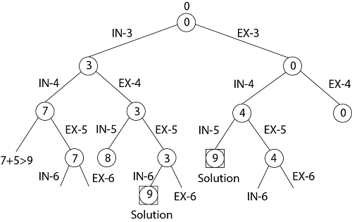
Sum of subsets Backtracking
S = (3, 4, 5, 6) and X =9.

Slide 55
Queries?

Slide 56
Thank you!

